Slide 1
Niche Health & Social Care Consulting
Investigating investment in Adult Mental Health Services

Slide 2
Source Data
3 excel files
Investment: 16210 observations against 3 features
Areas: 144 observations against 5 features
Service Type: 119 observations against 4 features

Slide 3
Data Quality
Data Collection?
Logical definition of human beings is that we are prone to making errors
Technology is good but sometimes has limitations e.g., mistakenly placing an extra zero can raise eye-brows
Was the data processed at any stage? If Yes, then is the raw data available or the manipulation process documented i.e., was care given to consider median instead of mean based on distributions? Any decoding/binning took place?
Is a readme file or data definition file provided to gain feature understanding their units and interactions with other variables i.e., wrong values could be recorded against features e.g., LIT column has numbers

Slide 4
Data Quality
Duplicate Records
A total of 117 duplicate entries in investment sheet. No duplicate record found in areas or service type
Occupies storage e.g., merging with other data sources could lead to exponential increase in duplication
Inflates values when aggregated resulting in unreliable measurements
Ingest time during debugging if an error occurs due to duplicated records

Slide 5
Data Quality
Accuracy
Negative spend value in Wolverhampton for “Psychological Therapy Services for Older People”. (-0.308). Is this an anomaly or an amount available to use?
Extremely high spend in Hertfordshire for “Care Home – Older People”. (27851.01) – Unit £000’s
A timestamp is not available for this data so it cannot be ascertained if the observations belong to the same time group e.g., if some areas reported values during the early part of the year and others later. Are there any missing values? If Yes, then what kind of missingness is it?
Inconsistent feature names across files, inconsistent case (“Halton”) can all lead to poor quality

Slide 6
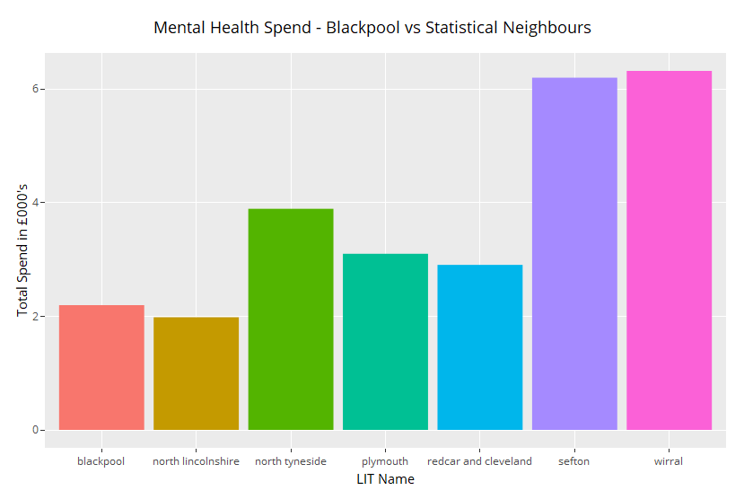
Blackpool vs Statistical Neighbours
Blackpool spends the second lowest amount
On Adult Mental Health Services just behind North Lincolnshire. Blackpool spends approx.
£200K less on adult mental health in comparison To Sefton & Wirral and approx. £400K less than North Tyneside.

Slide 7
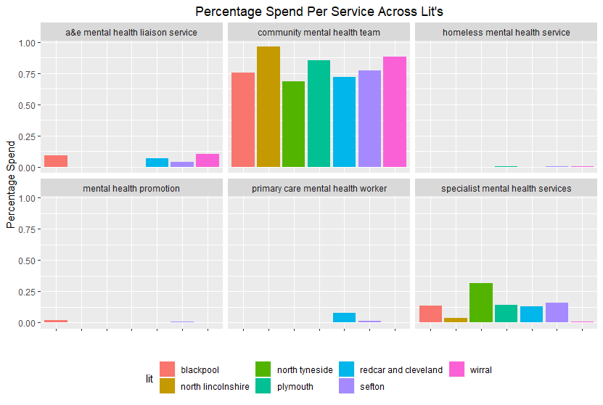
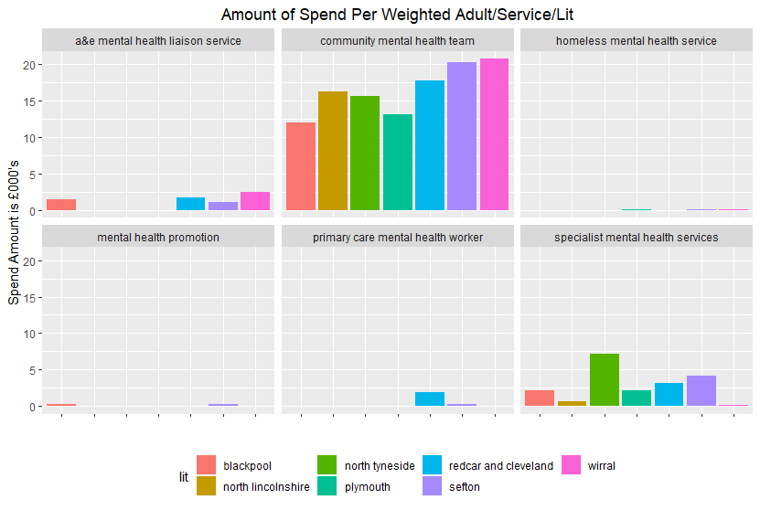
It is evident from the charts below that each LIT spends the largest percentage on community mental health teams including Blackpool but for spend per adult, Blackpool spends the least amount ~£12K in comparison to ~£20K+ in Wirral and Sefton. Blackpool is also not making a noticeable spend for primary care mental health workers or homeless mental health services

Slide 8
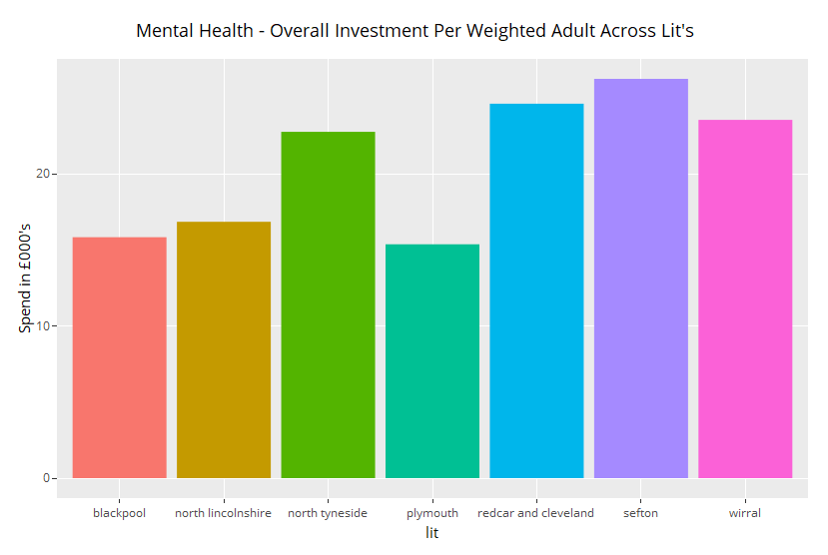
Blackpool vs Statistical Neighbours
Blackpool spends the second lowest
Overall amount (~£15K) per weighted adult. Blackpool spends approx. £10K less than Sefton, Redcar & Cleveland and ~£6K-£8K lower than Wirral and North Tyneside

Slide 9
Conclusion
Based on the assumption that LIT’s spending more towards mental health services for adults achieve prosperity amongst communities, Blackpool needs to either increase it’s spend for services neglected so far or, spread the spend more evenly. It could also be that Blackpool has fewer people suffering from mental health. The reasons behind levels of spend could not be figured out based on the information provided

Slide 10
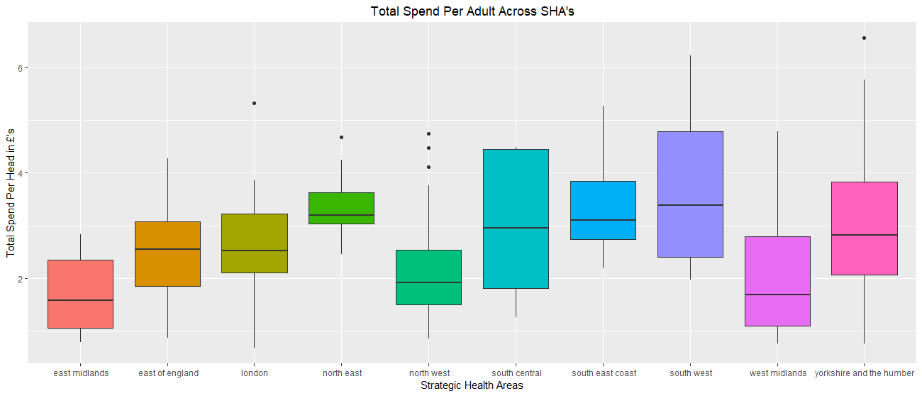
Comparison of Spending
A clear difference of spend per head across sha’s
Median spend for London and east of England is approx. same
Lowest spend per head belongs to London
South West & Central has the maximum variance

Slide 11
Data Processing
The following steps were taken to prepare data:
Filtered services where only “Mental” word occurred
Considered records for adults only age group
Capital Charge & Direct cost groups were selected
Total population calculated per SHA per LIT
Total spend calculated per SHA per LIT and converted to 000’s
Total spend per head calculated for each SHA and LIT – total spend divided by total population
A new indicator column created to differentiate between London & other areas

Slide 12
Comparison of Spending
From the previous boxplot, It was visible that total MHS per head not uniformly distributed across sha’s.
In order to select a suitable hypothesis test, the distribution of investment was visualised. (presented in the next slide)
Overall planned investment was right-skewed including extreme observations visible from x-axis scale. A log of planned investment turned into a nearly normal distribution
After data processing, distributions of investment in London and other areas were plotted and they both appeared nearly normal but a normality test “Shapiro-Wilk Normality Test” was conducted to confirm the claim

Slide 13
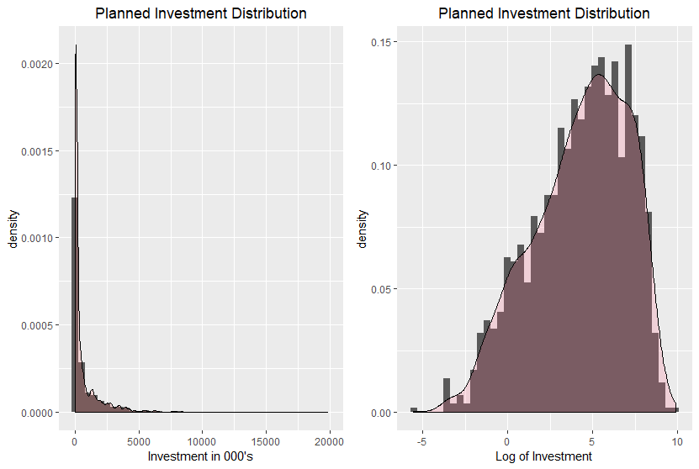
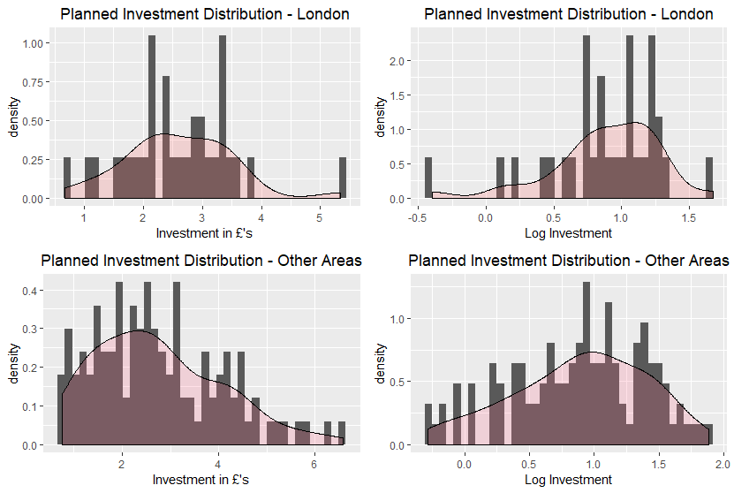

Slide 14
Normality Test
With the actual values of total spend per head, the distribution of London was not normal
The condition of normality was meet after taking log of total spend per head
Shapiro-Wilk Normality Test
 | Actual Total Spend Per Head |  |  | Log Total Spend Per Head
 | All Data | London | Other Areas | London | Other Areas
P-Value | 0.0009869 | 0.5166 | 0.001623 | 0.0393 | 0.05267

Slide 15
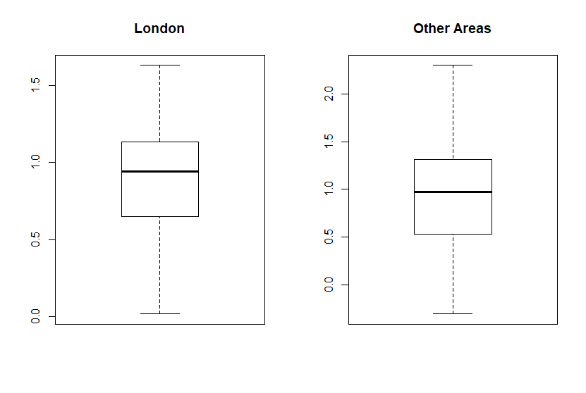
Variances

Slide 16
Hypothesis Test
The null hypothesis was
The mean of investment in London is equal to mean of investment in other areas of England
The alternate hypothesis was
The mean of investment in London is greater than the mean of investment in other areas of England
Confidence interval was kept at 0.95
Welch’s t-test was selected to validate the hypothesis based on the findings, normal distributions but unequal variances

Slide 17
Result
t = -0.046596, df = 62.24, p-value = 0.5185
With a p-value of 0.5185, there was insufficient evidence to reject the null hypothesis
Area Type | Group Means in £’s Per Head
London | 2.416264
Other Areas | 2.426087

Slide 18
Conclusion
The investment levels on mental health services per head in London and other areas of England are approx. the same
Having said that, we could compare London with other individual sha’s in the same way and find out more details

